Slide 1
Designing Lists & Schemas

Slide 2
Outline
New & Improved Events
List Relationships and Joins
Large List Support
Field & List Item Validation

Slide 3
New & Improved Events

Slide 4
New & Improved Events
New events in MSF 4.0
WebAdding & WebProvisioned
ListAdding & ListAdded
ListDeleting & ListDeleted
New Registration Capabilities
Site collection level event registration to support new events
SPSite & SPWeb event receiver registration via Features: new issue with SPSite or SPSite.RootWeb in registration
<Receivers ListTemplateId=“” Scope=“” />
Notes:
New events in MSF 4.0 based on customer demand around the creation of lists & SPWeb’s
These new events required new registration scopes & capabilities. Feature-based registration introduces a SCOPE=“” attribute

Slide 5
Post Synchronous Events
WSS 3.0 “after” events are exclusively asynchronous
Problem when wanting to do post processing after item submitted, but before displaying to user
MSF 4.0 adds new property on receiver definition to change “after” event to synchronous
SPEventReceiverDefinition.Synchronization
Notes:
MSF 4.0 introduces concept of synchronous post-events
Allows developer to do a little post-processing after the commit of the action, but before user is presented with the result of the post

Slide 6
Cancelling Events & Custom Error Pages
WSS 3.0 provided capability to cancel synchronous events & returning an error message
MSF 4.0 introduces capability to cancel error and redirect user to custom error page
Not possible on post synchronous events
Synchronous cancel with error URL
Only work within the SharePoint browser user interface
Won’t work with Office clients (any version)
Notes:
MSF 4.0 now allows developers to point to a custom error page rather than leverage the existing WSS 3.0 based “_layouts” stock page with an error message
Enables for more user-friendly error messages

Slide 7
Event Impersonation Improvements
WSS 3.0 events run in context of user who triggered the event
Certain things trigger events to run under System Account (workflow, etc), but doesn’t permit reverting back to user who triggered action
MSF 4.0 now adds the originating user & user token on SPEventPropertiesBase
Notes:
In WSS 3.0 when a workflow triggered an event by adding/changing something in a task list, the task item’s identity would be the system account that executed the workflow
In MSF 4.0 the same is true, but the SPEventPropertiesBase now contains properties that contain the user name & user token of the person who actually triggered the effective action (like started the workflow)

Slide 8
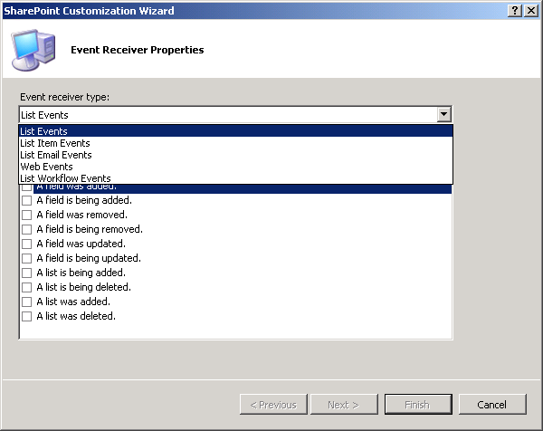
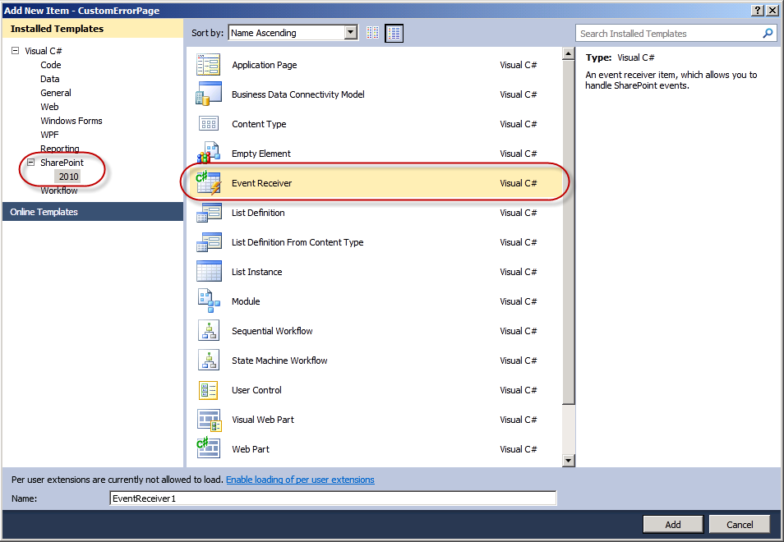
Events in Visual Studio 2010 Tools

Slide 9
New & Improved Events
demo

Slide 10
List Relationships & Joins

Slide 11
Relational Lists & Joins
MSF 4.0 introduces the capability to have a relationship behavior enforced by a Lookup field
New investments:
Projected fields into child lists
Joins
Relational integrity between parent & child lists
Introduces new security considerations and possible issues
Notes:
Discuss the new integrity constraints and the safety features (ie: can’t delete 1k items on a cascade)
Discuss setting up a join using equiv of SPQuery
Discuss nuances with security (what if user doesn’t have rights on parent list?)
Only relationships can exist where a lookup has been established

Slide 12
Relational Lists: Projected Fields
Projected Fields
Extra field pulled from parent list into view of child list
Via browser interface, users add a lookup from another list just like WSS 3.0…
Then, user can select a secondary lookup field to pull into the child list
Notes:
Projected fields are fields from a parent which are referenced and displayed in the child list
These fields are read-only, but enable a more join-like view

Slide 13
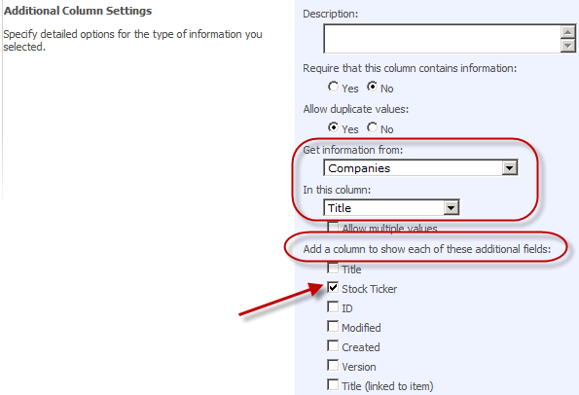


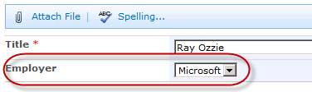
Relational Lists: Projected Fields

Slide 14
Relational Lists: Joins
With relational lists, MSF 4.0 adds support for joins
Joins can only be implemented by developers using the API, CAML or SharePoint Designer 2010
New properties on SPQuery:
SPQuery.Join
SPQuery.ProjectedFields
Use SPLinq instead of CAML to join two lists in code
Notes:
Joins can be implemented using CAML query, but much easier to use LINQ
CAML schema updated to support LINQ based joins
LINQ will generate the CAML under the covers… LINQ much easier to write than new CAML schema
Can also create joins via API using two new properties: SPQuery.Join & SPQuery.ProjectedFields

Slide 15
Relational Lists & Joins
demo

Slide 16
Large List Support

Slide 17
Large List Support
MSF 4.0 lists can now support 50M items
Under read scenarios
Platform Investments:
Configuration options for administrators per Web application (Central Administration)
Site collection & list administrators can request privileged operations (expensive queries)
Default Query Restrictions
Notes:
SharePoint can support lists with lots of data, but the larger the dataset, the bigger burden queries put on the server
New controls for admins to block expensive queries
Doesn’t help you view more data (doesn’t directly address the “2000 item issue”) but instead more of a heath & monitoring thing

Slide 18
Managing Large Lists
Web Application Settings:
List query size threshold (w/ warning threshold)
Allow object model override
Enables developers to ignore query safety checks and run an unsafe query via SPQuery or SPSiteDataQuery
Requires special priv. 2 different limits:
Normal user – 5,000 items
Super user – 20,000 items
Configure time window for expensive queries
Notes:
SharePoint will attempt to execute the query provided
If query returns records in excess of 5,000 items, it will throw an exception saying it’s too big and it has been throttled
Thus, SharePoint will ALWAYS try to run the query, but when it exceeds the threshold, it aborts it… even if the real result set would be 5,001 items
Threshold configurable by PowerShell

Slide 19
Managing Large Lists (2)
SPList:
Kicks in when list count meets certain threshold List administrators will see warnings & messages when lists exceed thresholds
Notes:
When a list exceeds the warning threshold, a message is displayed in the list settings page to warn the list admin it’s reaching the upper limit
When list exceeds the upper limit, throttling kicks in

Slide 20
Querying Large Lists
If throttling is enabled & list limit exceeded threshold, users won’t be able to query lists by default via API
Can override querying the large list settings provided Web App configured to allow it
Override using:
SPQuery.RequestThrottleOverride
SPSiteDataQuery.RequestThrottleOverride
Only users with proper permissions get override ability (set via policies)
Notes:
Throttled lists, which is triggered by exceeding the upper limit, will cause queries with a result set in excess of the upper limit to throw an exception
However, this can be overridden by users with required permissions via code

Slide 21
Wide List Throttling
Support for number of fields that makeup a SPListItem
MSF 4.0 – SPListItems are limited to 6 rows
SPListItem limited to 8KB of data
Maximum number view fields selected for a joined of joins on a list view = six
Exception thrown if user tries to select fields from more than six fields from the joined lists
If no view fields specified (maximal view), only the first six pulled
Notes:
MSF 4.0 has introduced some constrains that block very large lists to protect the server
Max of 8kb of data per list item (not including attachments)
Max of six projected fields allowed on joins

Slide 22
Unique Column Constraints
Lists can now contain columns that require all values in all items in the list for that column to be unique
Scoped at SPList, not SPFolder, level
Unique columns must be indexed (automatically configured)
When making existing column unique, existing data is validated
Uniqueness determined by SQL collation
Ex: Case sensitive / insensitive
Notes:
Columns can be flagged as unique
If unique, no dupes allowed
If applied on an existing column in an existing list, the action will fail if dupes are already present

Slide 23
Working with Large Lists & Unique Columns
demo
Notes:
Show how to set it up on new list & existing list
Show how to how it works & error message
Show the list UI
Run the filler app
Show the list UI hinting at potential issues
Explain only certain ops by certain people can be managed
PowerShell
$sitecol = get-spsite “http://...”
$sitecol.WebApplication.MaxItemsPerThrottledOperation
$sitecol.WebApplication.MaxItemsPerThrottledOperationWarningLevel
$sitecol.WebApplication.AllowOMCodeOverrideThrottleSettings
$sitecol.WebApplication.UnthrottledPriviledgeOperationWindowEnabled
$sitecol.RootWeb.Lists[“Tasks”].IsThrottled
Column Level Validation
New Column “Company Size” = NUMBER
Formula: =[Company Size]>=10
Demo setting the value to 5 to throw error, then 11 to show it’s good
List Level Validation
Show the UI
Unique Columns
Show ALLOW DUPLICATE VALUES in the column settings & how it must be indexed

Slide 24
Field & List Item Validation

Slide 25
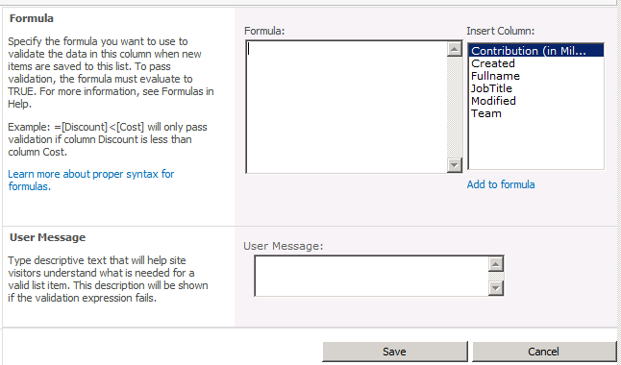
List Item Validation
Items are validated against a custom formula when saved
Notes:
Two new types of constraints on Lists & List Items in MSF 4.0: column-level & row-level
Can specify a validation condition when creating the column or from the list settings

Slide 26
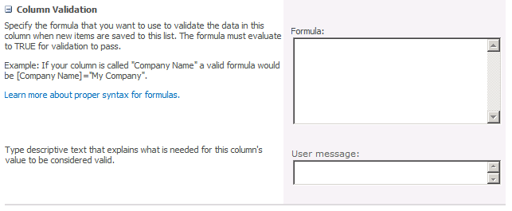
List Item Field Validation
Similar to list item validation, each column can be validated using a custom field, or by referencing other fields

Slide 27
Summary
Improved Support for Events
List Relationships and Joins
Large List Support
Field & List Item Validation

